Slide 1
FLHR Electrical Subsystem
Akhil Metta, Godwin Mathew Abraham Lnu, Jacob Kreitzer, Vishal Pillai Ayyappan

Slide 2
Agenda
Introduction
Systems Engineering Management Plan
Project Management Plan
Business Requirements Specification
Stakeholder Requirements Specification
System Requirements Specification
Systems Lifecycle
Systems Domains

Slide 3
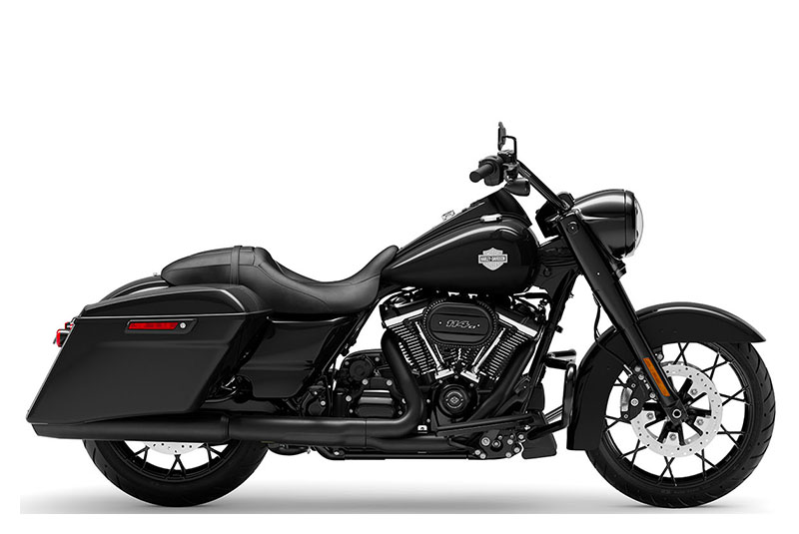
Introduction
The Harley Davidson Road King (FLHR) is a touring motorcycle comprised of seven different subsystems
These subsystems are being independently engineered by teams for integrating into the overall FLHR system
The focus of this presentation will be on the electrical subsystem only

Slide 4
Project Management Plan (PMP)
The PMP set forth for this project constituted the baseline configuration of the project and how it would be managed.
Risk Management
Risks will be identified as any item that may affect cost, schedule or delivery and will be identified during the project assessment process
Each risk will have a risk profile associated with it and a complementary countermeasure will be proposed
A risk report will be prepared using this data for reference throughout the project
Configuration Management
A baseline configuration is decided during the early stages to establish hierarchy
Any and all changes to systems configuration will be subject to an engineering change order (ECO) process that will include review of change and implementation strategy
Human Resources Management
Human resources will identify any gaps in talent needed in the project and fill them with correct talent, alongside facilitating any possible work conflicts during the project

Slide 5
Project Management Plan (PMP)
Quality Management
Quality is a mechanism for controlling project deliverables and ensuring that they remain within both stakeholder and systems requirements. Engineered items will all be subject to quality review by appropriate SME’s
Stakeholder Management
Stakeholders will be integral in system development and stakeholders are expected to provide functional requirements and attend review gate meetings to approve project progress
Integration Management
Operations management group will handle decisions needed to integrate different facets of the project together and are the overarching authority for any integration processes

Slide 6
Systems Engineering Management Plan (SEMP)
A Systems Engineering Management Plan (SEMP) is a document that outlines the overall approach, processes, and resources for managing and implementing systems engineering activities for the project.
Program Technical Requirements
This section will briefly highlight the technical requirements that will be necessary for the system.
The systems architecture and boundaries will be discussed, as well as the different interfaces that will occur between the system and different stakeholders.
Architecture and Interface Control

Slide 7
Business Requirements Specification (BRS)

Slide 8
Stakeholder Requirements Specification (StRS)

Slide 9
Systems Requirements Specification (SyRS)

Slide 10
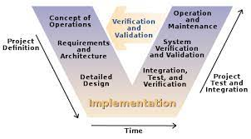
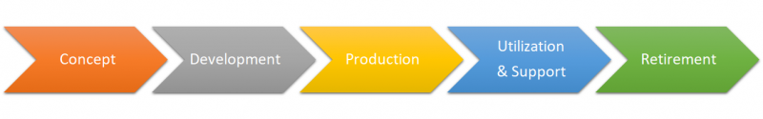
System Lifecycle

Slide 11
System Domain(s)
The four systems domains in this project include:
Requirements and Capabilities
The requirements set forth by stakeholders to identify key features of the project that will affect performance
Behavior
The actions and repercussions of how the system intermingles with its surroundings
Architecture
The physical and non-physical constructs needed to produce and maintain the system (manufacturing sites, ERP)
Validation
Each component of the system will be need to be validated by the criteria set forth by stakeholders and outside standards, they cannot be integrated into the system until passing validation

Slide 12
Questions?

Slide 13
References
Systems engineering life cycle. Systems Engineering Life Cycle - Satellite Wiki. (n.d.). Retrieved April 26, 2023, from https://www.aero.iitb.ac.in/satelliteWiki/index.php/Systems_Engineering_Life_Cycle
Shevchenko, N. (2020, December 21). An introduction to model-based systems engineering (MBSE). SEI Blog. Retrieved April 26, 2023, from https://insights.sei.cmu.edu/blog/introduction-model-based-systems-engineering-mbse/

